Slide 1



Power BI overview

Slide 2
Unlock insights on any data
Power BI overview
Turning data into a business advantage

Slide 3








The world of data is changing
10x increase every five years
Big
Data
Consumerization of IT
4.3 connected devices per adult
85% from new data types
27%
using social media input
“By 2015, organizations that build a modern information management system will outperform their peers financially by 20 percent.”
– Gartner, Mark Beyer., “Information Management in the 21st Century”
Notes:
Big Data – the size, type, shape of data that business are analyze is changing.
Data from sensors: RFID tags in manufacturing, or location data for company’s with large fleets.
Data from social media like facebook, twitter, Linked-In – for analyzing the success of a marketing campaign or to assess customer sentiment or to gather feedback to help shape products or services.
Public data – traffic or weather feeds, or data published from data.gov initiatives etc
Being able to easily tap into these data sources from smarter analytics to drive business insight is a prevalent theme.
Consumerization of IT – this is about choice. I as an individual want to work on the device of my choice. From wherever I want to work. This extends beyond devices to include apps and user experiences. I search for information all the time at home on the web, I want to have that same experience at the office. I’ll talk today about how we’re bringing these experiences to the world of data as well.

Slide 4

Everyone should have access to the data they need
Notes:
Our Vision:
Today only about 10% of an organization’s business users can do business analytics. We believe everyone should have easy access to the data they need to make informed decisions. That’s our goal.
The challenge is that accessing and analyzing data can be a daunting task. Where does the data live? How do I access it and get it into the right format so that I can analyze it?
To solve this problem we need to make data of all types much easier to find, access, analyze, and share. This is the path we’re on.

Slide 5



A powerful new way to work with data
Self-service business intelligence and analytics with Excel and the power of the cloud
Analyze in Excel
1 Billion Office Users
Collaborate in Power BI for Office 365
1 in 4 enterprise customers on Office 365
Discover
Analyze
Visualize
Share
Question
Mobility
Q&A
Scalable | Manageable | Trusted
Notes:
Our Approach:
Excel is the most commonly used analytical tool for business users – it truly is accessible to anyone. No other vendor has the ability to reach a billion users through tools they already know and use. Today Excel delivers end-to-end self-service BI functionality through capabilities such as Power Query, Power Pivot, Power View and Power Map. With the accessibility of Excel and proliferation of Office 365, we can lower the barrier of entry for businesses who want to take advantage of the benefits of business intelligence by putting the right analytics tools in everyone’s hands with no friction.
Ease of deployment through Office 365.. Power BI dramatically simplifies and reduces the time it takes for IT to setup and manage the complex infrastructure needed for an enterprise wide BI platform. Power BI enables businesses to balance between the needs of business users working in Excel and an IT department’s requirements for agility, monitoring and governance. IT can also provide business users the ability to search and access IT sanctioned corporate data sources both on premises and in the cloud while monitoring query usage against their data.

Slide 6
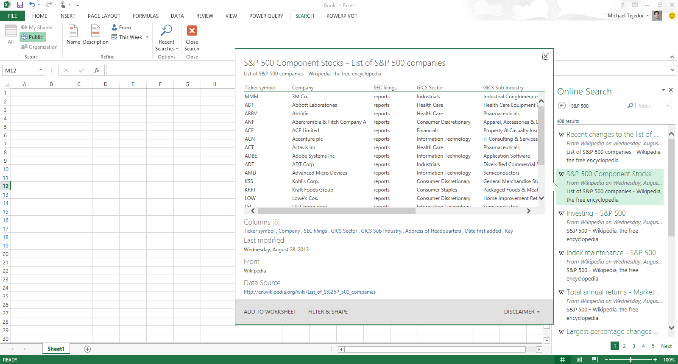
Analyzing data with Excel
Easily discover and access public and corporate data
Discover
Analyze
Visualize
Explore
Notes:
Powerful Self-Service BI in Excel 2013: We are taking our most powerful business intelligence solutions and building them directly into Excel.
There has never been such an abundance of available and useful information as there is today both across the web and across your organization. However, users are challenged with effectively discovering and connecting to this information so that they can gain the insights they need.
Power Query enables information workers with a familiar and intuitive experience for finding and connect to data from within Excel. Providing them with ease of combining and transforming this data so that it can be analyzed and visualized for deeper insight. Power Query supports a wide variety of data sources including relational, structured and semi-structured data, OData, data from the Web, Hadoop, as well as Data Search capabilities that provide users with a search experience for data, returning relevant data sets from across the enterprise and from external sources.

Slide 7
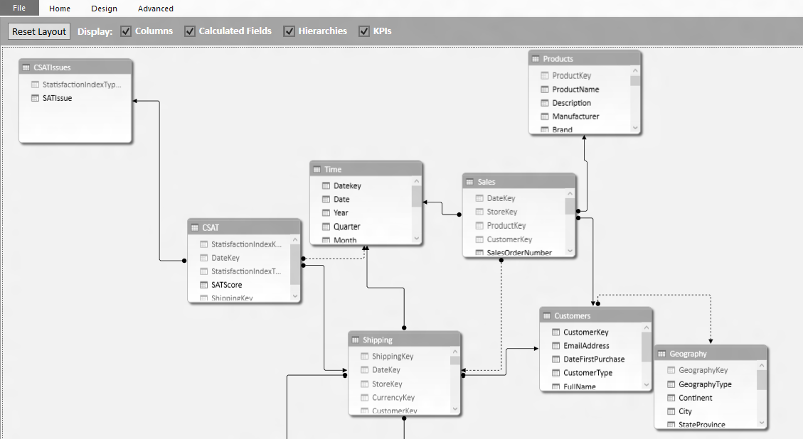
Analyzing data with Excel
Model & analyze 100’s of millions of rows of data
Discover
Analyze
Visualize
Explore
Notes:
Power Pivot allows Excel users continue to create sophisticated models with data in Excel by creating relationships, custom measures and calculations, hierarchies, and KPI’s. Power Pivot models process data in-memory so that users can analyze 100’s of millions of rows of data with lightning fast performance. Power Pivot also compresses the data to reduce file sizes.

Slide 8
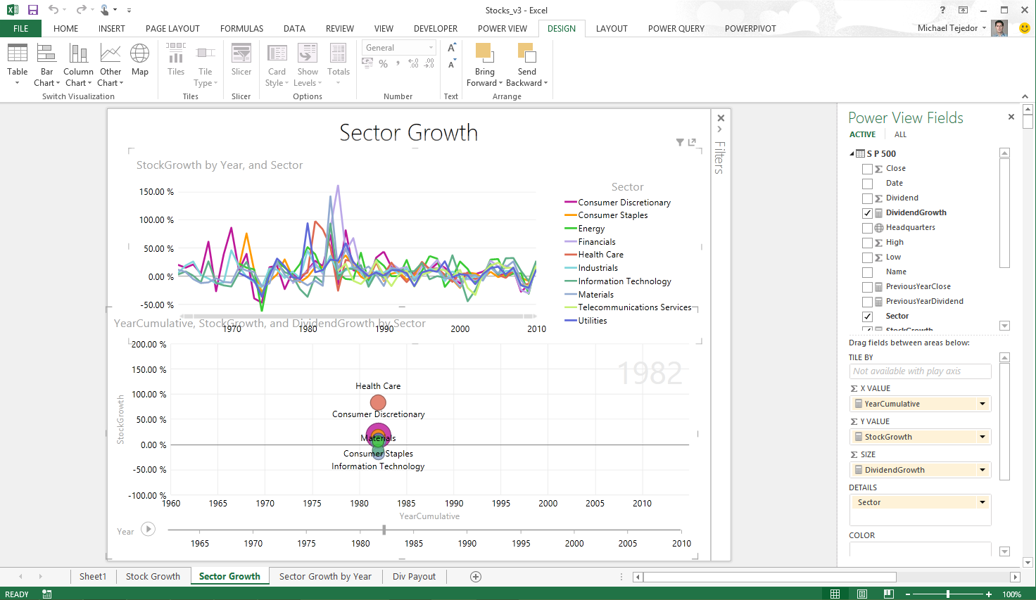
Analyzing data with Excel
Explore your data with interactive visualization
Discover
Analyze
Visualize
Explore
Notes:
In Excel 2013 we also introduced a host of new visual capabilitie. Quick Analysis provided immediate views of various visualization options and reduced the time to add them on your data, Chart Recommendations used intelligent heuristics to suggest charts. The charting functionality provided live preview, richer data labels, and easier ways to add chart elements, apply styles, and filter directly from the charts.
Excel 2013 also introduced Power View, and with it brought beautiful interactivity to visualizations and more fluid exploration capabilities.
Power View easily creates visual reports and analytical views through interactive charts and graphs that help you explore and present your data in bold new ways in Excel. Customers can create dashboards of interactive visualizations that provide instant answers to variety of questions. This capability has resonated well with our customers, one of whom mentioned the rigidity of static snapshots during meetings has been replaced by the “Power View lifestyle”, their term for the transformational way of presenting and using information.

Slide 9
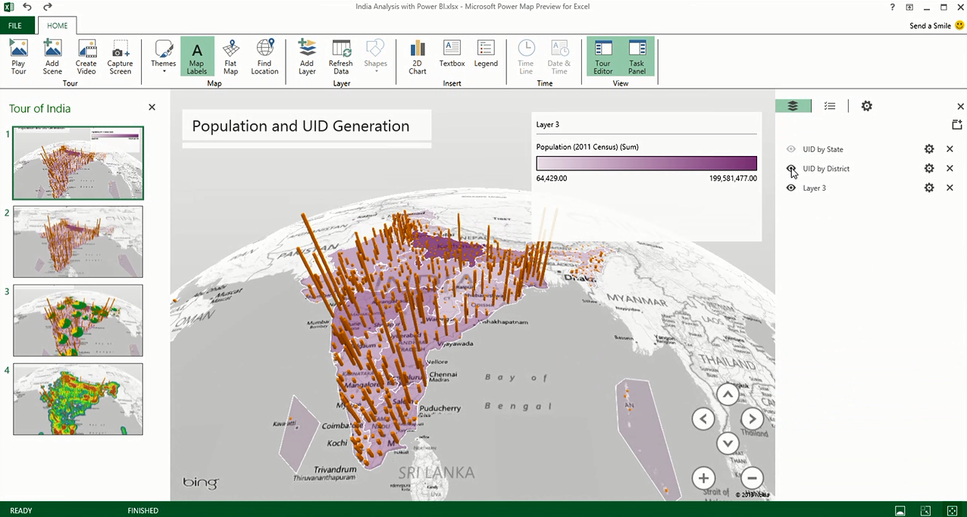
Analyzing data with Excel
Uncover new insights with 3D geospatial analysis
Discover
Analyze
Visualize
Explore
Notes:
Increasingly, we have access to geospatial data, and recently introduced Power Map brings new 3D visualization tool for mapping, exploring, and interacting with geographical and temporal data to Excel, enabling people to discover and share new insights such as trends, patterns, and outliers in their data over time. In addition, with Power Map, users can easily capture and distribute their insights in the form of an interactive movie, telling compelling stories about their data.
Inspiration for Power Map came from Microsoft Research’s WorldWide Telescope project. Launched in 2008, WorldWide Telescope is used by the astronomy community to visualize imagery and data, essentially giving astronomers an observatory in a PC.
What’s Next?
The importance for data visualization is on the rise. Deeper interactivity that blend analysis and visualizations even more fluidly, newer types of visualizations that enable you to see deeper insights more easily, richer experiences on the devices customers use most, and great storytelling experiences are just a few of the areas we’re investing in to make sure Excel remains the data productivity app of choice as our customer needs evolve.

Slide 10
Analyzing data in Excel
Demo
Notes:
SUGGESTED DEMO:
Ensure you have logged in and navigated to your Power BI site and that the setup workbook (AW Sales Analysis Demo1) has been uploaded to the Power BI site.
Open the workbook not in Power BI but straight from SharePoint using Excel Online to avoid the delay related to loading the workbook for the first time.
Talking Points
The workbook contains a data model sourced from on-premise and external data. The reports are all based on this data model.
The workbook is centrally and securely stored in the cloud.
Demo Steps
Interact with the Sales Dashboard by selecting slicer members.
To hide the Parameters pane, click the arrow.
Select the Sales Performance worksheet.
Interact with the filter in cell B1.
Collapse United States.
Select the Salesperson Sales sheet.
Interact by changing a Year slicer value and selecting a different salesperson.
Select the Sales by Country sheet.
Interact by changing a Year slicer value.
Power Map Tour (won’t work in Power BI)
Open Power Station Sample.xlsx
Go to Insert Tab, in Power Map Group click on Map
If there is no data, without closing PowerMap navigate back to spreadsheet, select all cells, click the PowerMap dropdown and select “Add Selected Data to Power Map”

Slide 11
A powerful new way to work with data
Self-service business intelligence with familiar Excel and the power of the cloud
Analyze in Excel
1 Billion Office Users
Collaborate in Power BI for Office 365
1 in 4 enterprise customers on Office 365
Discover
Analyze
Visualize
Share
Question
Mobility
Q&A
Scalable | Manageable | Trusted
Notes:
Power BI for Office 365 is a complete self-service BI solution delivered through Excel and Office 365 that provides data discovery, analysis, and visualization capabilities to identify deeper business insights from data in Excel. The Power BI for Office 365 service is a cloud-based solution that enable collaboration and reduces the barriers to deploying a BI environment for sharing reports and accessing information.

Slide 12
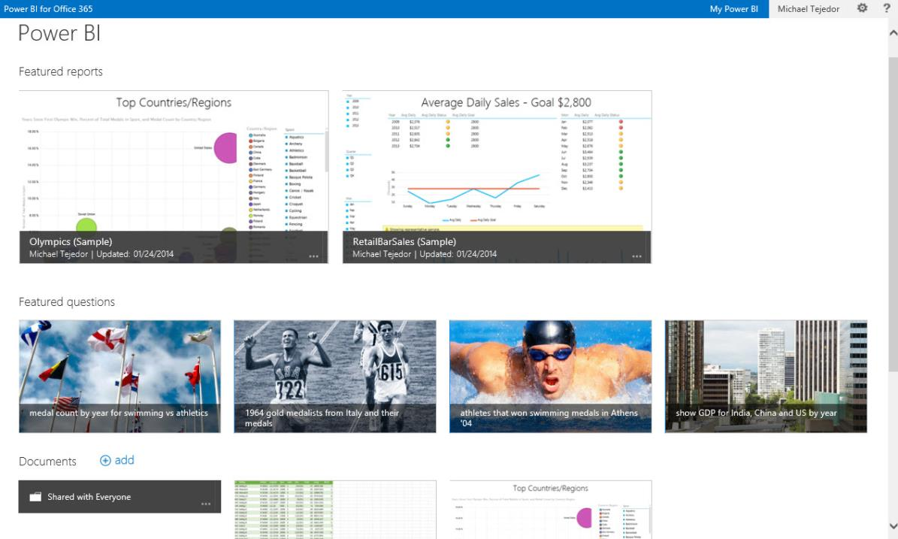
Share & collaborate with Power BI for Office 365
BI Sites
Quickly create collaborative BI sites
Shared Queries
Data Refresh
Data Search
Mobile Access
Natural Language Questions
Notes:
Collaborate and stay connected with Office 365: Extends Self-Service BI with ease of collaboration and sharing of reports and data sets which reducing friction from deployment and adoption.
Power BI Sites – quickly create collaborative BI sites for your team to share reports. Larger workbook viewing is now supported (up to 250MB) so that users can view and interact with larger workbooks through the browser. Power BI sites provide a highly visual experience for sharing reports including live report tiles to ease in locate the right report quickly.

Slide 13
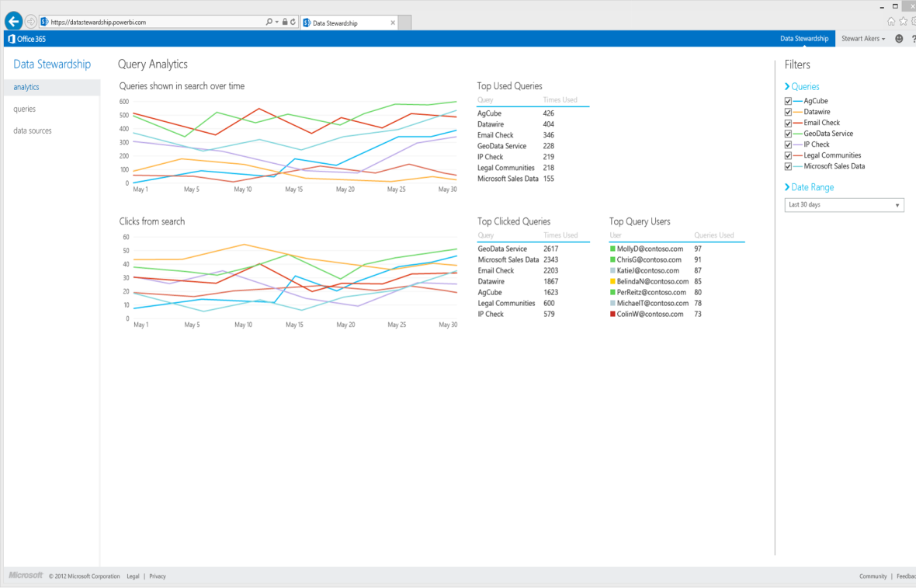
Share & collaborate with Power BI for Office 365
BI Sites
Manage data queries for the team
Shared Queries
Data Refresh
Data Search
Mobile Access
Natural Language Questions
Notes:
Manage data queries for the team
With Power BI people can share not only workbooks but also the queries they create using Power Query in Excel. This allows members of the team to build and manage data queries for others to use when creating their own reports.
Once published to Power BI users can define who they want to share their data queries with and track who’s accessing which queries. Data queries are registered with the Data Catalog so that they can be easily discovered through data search in Excel. If a user tries to access a query but they do not have access to the underlying data source, a workflow will allow them to request access from the DBA responsible for the data.

Slide 14
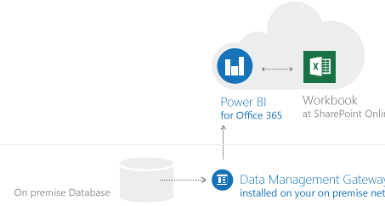
Share & collaborate with Power BI for Office 365
BI Sites
Keep reports up to date with scheduled data refresh
Shared Queries
Data Refresh
Data Search
Power BI for Office 365
Workbook
Cloud
Mobile Access
On Premise
Data Management Gateway
Installed on-premises
Natural Language Questions
Notes:
Keep reports up to date with data refresh
A cloud based Business Intelligence solution must enable you to keep your reports connected to your on-premises data to keep their data fresh.
Keep your reports up to date by scheduling when the data should refresh. The Data Management Gateway allows reports that have been saved to the cloud to connect back to on-premises data sources to refresh data.
Scheduled data refresh for your reports
Connect cloud based report to on-premises data
The data management gateway is installed and configured by IT on-premises, and enables reports to connect through the firewall back to their underlying data sources.

Slide 15
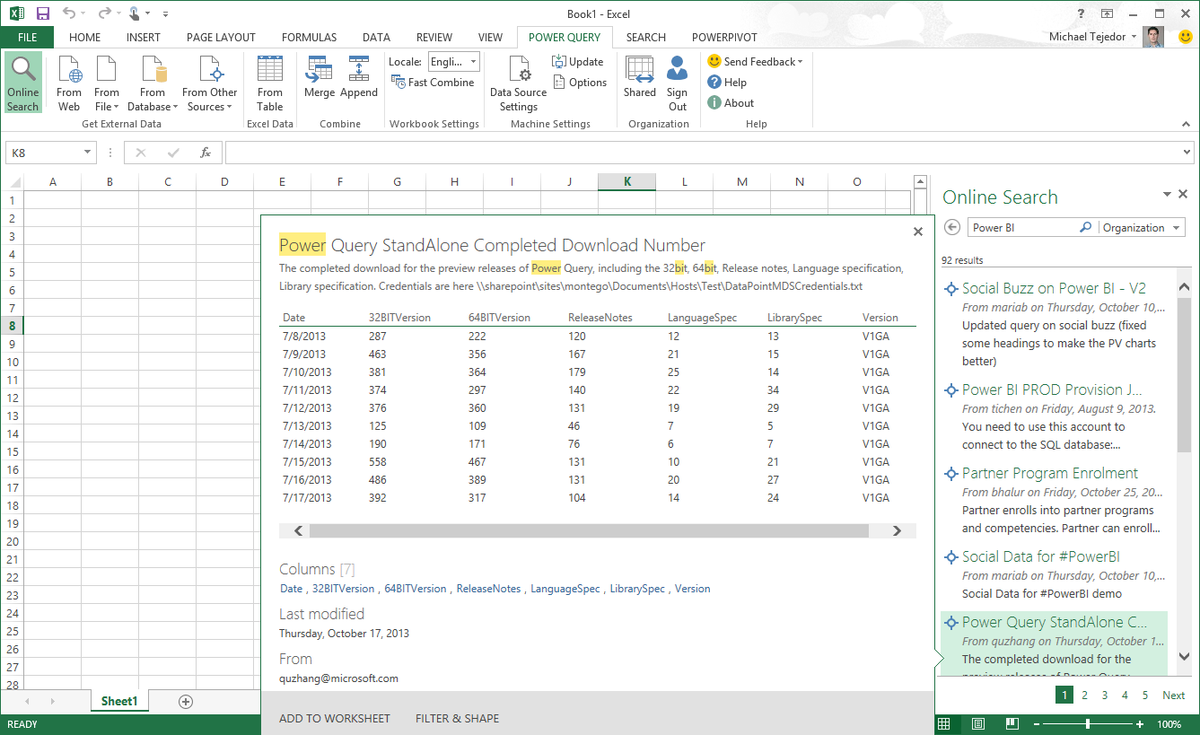
Share & collaborate with Power BI for Office 365
BI Sites
Maintain a data catalog of searchable data
Shared Queries
Data Refresh
Search for:
Public Data
Corporate Data
Shared Queries
Data Search
Mobile Access
Natural Language Questions
Notes:
Maintain a Data Catalog of searchable data
IT departments can now use the Data Catalog feature of Power BI to make it easier for everyone to find and connect to corporate data.
The Data Catalog is a feature of Power BI which serves as a search engine for data, the IT department can register data from across the organization with the Data Catalog. This data is then searchable from within Power Query in Excel so that users can easily find and connect to corporate data they need without having to call IT with one off data requests.
When searching for data from Excel, users will now receive results from public data sources, corporate data sources managed by IT, as well as data queries that colleagues are publishing into Power BI. Making it easier to discover what connect exists and reducing duplicative efforts across the organization.
The Data Catalog also tracks data access and usage across the organization, providing IT with better telemetry for data governance and resource allocation.

Slide 16
Share & collaborate with Power BI for Office 365
BI Sites
Stay connected with mobile access to your reports
Shared Queries
Data Refresh
Data Search
Mobile Access
Natural Language Questions
Notes:
Stay connected with mobile access to your reports
Mobile BI access to reports in Office 365 is provided through two mechanisms. First, Excel and Power View reports now render in HTML5 so that you can access these reports from any HTML5 compatible browser, on any device. The second, is through native mobile BI apps connect to the Power BI service to keep users connected to their favorite reports, which they can view and explore from their tablet devices. Windows 8.1 tablet devices will be supported are currently supported and iOS will be supported in H2 of CY2014.

Slide 17
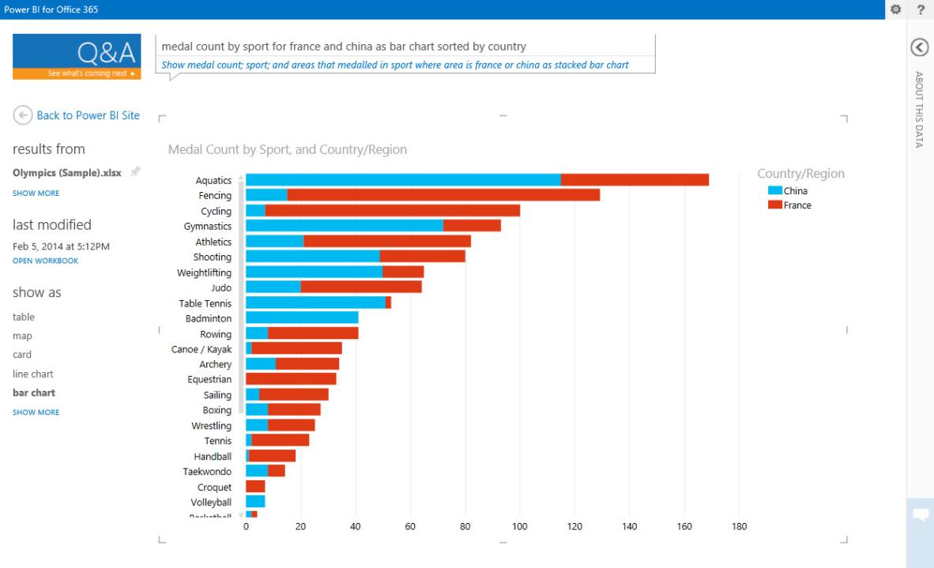
Share & collaborate with Power BI for Office 365
BI Sites
Ask questions of your data in natural language
Shared Queries
Data Refresh
Data Search
Mobile Access
Natural Language Questions
Notes:
Power BI enables business users to interact with their data in natural language. The natural language query capability allows users to ask questions of their corporate data and get instant and visual results. The experience is instantaneous and uses natural language query. Q&A interprets the semantics of the question the user is asking and serves up the correct interactive chart or graph.
It’s as easy as going to a colleague to ask a question. This dramatically increases how many business users can get more value from their existing BI solutions.

Slide 18
Share and collaborate with Power BI for Office 365
Demo
Notes:
SUGGESTED DEMO:
Demo featuring Power Query, Power View, Power Pivot and Power Map in Excel 2013. Demonstrate stage two of data science process – making it possible for everyone to form theories, analyze and refine – to work with big and small data using familiar powerful tools. Ultimately revealing insights.
DEMO ASSETS:
BI Demo Catalog
https://microsoft.sharepoint.com/teams/BIDemoCatalog/SitePages/BI%20Demo%20List.aspx
Launch in a Box
http://infopedia/Pages/EventMaterials.aspx > select ‘Demos’ on the left-hand sidebar
SUGGESTED DEMO:
Ensure you have logged in and navigated to your Power BI site and that the setup workbook (AW Sales Analysis Demo1) has been uploaded to the Power BI site.
Show that the same features are available but the PowerView sheets (Salesperson Sales, Sales by Country) can be viewed in HTML5 (Link bottom right hand side) which is good for Mobile and Tablets

Slide 19

MediaCom
“The fact that Power BI is part of Office 365 is tremendous. One skill that all our people have is Excel, with BI built on top of Excel, we don’t have to train them on anything new – they can figure this out on their own.”
Lowell Simpson CIO MediaCom
Notes:
MediaCom, a media agency with 4,600 employees, needed a way to measure the health of the ad campaigns it created for clients in order to optimize campaign performance and “spend” across TV, print, radio, search, display, events, and web. This process was difficult given the large number of diverse datasets from third party vendors (Nielson, comScore, Twitter, YouTube etc.) that needed to be integrated in order to create a representative score. Using Power BI, MediaCom brings these datasets into a unified dashboard for real-time data analysis and uses a collaborative BI site where they account team can ask natural-language questions that instantly return answers in the form of charts and graphs. With Power BI, MediaCom anticipates analyses in days vs weeks, supporting adoption across the account and saving up to millions of dollars per campaign.
Success:
MediaCom can now optimize their digital campaigns daily instead of weekly. They expect more successful campaigns, more clients, and happier clients.
With Power BI it took one person a couple of hours to create reports that used to take several weeks and a team of several people.
Account teams can use faster analysis to respond to smaller problems before they evolve into larger problems and their clients are better and more frequently informed of campaign status.
The ease of use of the product has led to higher adoption.
Campaigns are now 10% more productive which has produced savings up to millions of dollars per campaign.

Slide 20
A powerful new way to work with data
Analyze in Excel
Collaborate in Office 365
Discover
Search, access, and transform public and internal data sources with Power Query
Share
Share data views and workbooks refreshable from on-premises and cloud based data sources, with Power BI Sites
Analyze
Easy data modeling and lightning fast in-memory analytics with Power Pivot
Question
Ask questions and get immediate answers with natural language query
Q&A
Visualize
Bold new interactive data visualizations with Power View and Power Map
Mobility
Mobile access through HTML5 and touch optimized apps
Scalable | Manageable | Trusted
Notes:
To summarize – Microsoft is making data and analytics truly accessible by bringing these capabilities directly to the tools that people use every day.
With both Excel and Power BI for Office 365, you can give everyone in your organization a powerful new way to work with data. In Excel, you can now discover, analyze, and visualize data like never before to find valuable business insights. With Power BI for Office 365 you can easily deploy a cloud-based BI environment for users to share insights, collaborate and access reports, from anywhere.

Slide 21

Next Steps
Try Power BI for Office 365 at: www.powerbi.com

Slide 22
Analyzing data with Excel
Discover
Easily discover and access public and corporate data with Power Query
Analyze
Model & analyze 100’s of millions of rows lightning fast with Power Pivot
Visualize
Explore and visualize data in new ways with Power View and Power Map
Notes:
Powerful Self-Service BI in Excel 2013: We are taking our most powerful business intelligence solutions and building them directly into Excel. These solutions package the data discovery, analysis and visualization process into one self-service BI solution, which is essential for business users who are looking to get bigger returns on their data.
Discover:
Power Query – easily discover and connect to data from public and corporate data sources. This includes new data search capabilities, as well as capabilities to easily transform and merge data from multiple data sources so that users can continue to analyze it in Excel.
Analyze:
Power Pivot – continue to create sophisticated data models with that data in Excel by creating relationships, custom measures, hierarchies, and KPI’s. Power Pivot models run in-memory so that users can analyze 100’s of millions of rows with lightning fast performance.
Visualize:
Power View – Easily create visual reports and analytical views through interactive charts and graphs that help you explore and present your data in bold new ways in Excel.
Power Map – gives users the ability to plot geographic and temporal data visually on Bing Maps, analyze that data in 3D, and create interactive tours to share with others. It delivers visualization capabilities that might have never been seen in traditional 2D tables and charts, and enables users of all levels to do self-service BI directly in Excel to create powerful data models, and explore and visualize that data in Bing Maps. Inspiration for Power Map came from Microsoft Research’s WorldWide Telescope project. Launched in 2008, WorldWide Telescope is used by the astronomy community to visualize imagery and data, essentially giving astronomers an observatory in a PC.

Slide 23




Power BI connectivity to SAP BusinessObjects BI Where familiar business tools meet trusted enterprise data
Single version of truth
Excel
Power BI
Instant productivity
Optimized business performance
SAP BusinessObjects BI
Notes:
Talking Points:
[Click]
Microsoft and SAP have recognized an opportunity for helping our customers reimagine their businesses that stretches across the data chasm.
[Click]
It begins in Microsoft Excel and Power BI for Office 365…
[Click]
and stretches across to SAP BusinessObjects.
[Click]
Today, we are excited to announce the public preview of Power BI connectivity to SAP BusinessObjects BI, a joint business intelligence interoperability solution. With this new solution, users can now seamlessly connect to SAP BusinessObjects BI Universes as another supported data source in Power Query for Excel, enabling them to access and analyze data across the enterprise and share their data and insights in the cloud and any device through Power BI.
Users can rely on the latest, most accurate, and trusted enterprise data directly in Excel through an SAP BusinessObjects BI Universe without having to wrestle with copying and pasting or manually importing data. Companies that have made investments in both BI stacks can now effectively leverage their technology investments to maximize ROI. IT can use the connectivity to continue to manage critical company data sources while giving business users access to trusted enterprise data in familiar tools they use every day without requiring them to learn new skills.
Multiple large joint customers are already using the preview today and experiencing the benefits created through the interoperability. They require this connectivity to ensure business users can bring trusted enterprise data from SAP BusinessObjects BI Universes into the familiar and powerful user experience of Microsoft Excel.
[Click]
The connectivity promotes a single version of truth with the ability to access and analyze source data reliably. Consistent data in both stacks. Access TO latest, accurate, trusted data. Familiar business friendly Data Semantics.
[Click]
Users become instantly more productive using familiar tools with trusted enterprise data at their fingertips. FAMILIAR TOOLS, TRUSTED ENTERPRISE DATA. NO HASSLE DATA REFRESH. EASY, SIMPLE, AND WELL INTEGRATED TO EXISTING WORKFLOWS.
[Click]
LEVERAGE EXISTING INVESTMENTS. IMPROVED PROFITABILITY FROM FASTER, BETTER, MORE TIMELY DECISIONS. CREATE INFORMATION DRIVEN CULTURE THROUGH BROADER BI REACH

